Slide 1
Writing Sign Production for ASL Vocabulary
American Sign Language

Slide 2
Introduction: Writing Sign Production for ASL Vocabulary
There are 5 concepts that help us to write down how signs are produced.
Handshape
Location
Palm Orientation
Movement
Non-Manual Signal (NMS)

Slide 3
Using Example Signs to Help Explain 5 Concepts
The following 3 vocabulary words (noticed they are written in all capital letters) will be broken down concept by concept:
(1) GREEN
(2) SOMETIMES
(3) SCIENCE

Slide 4
Concept 1: Defining a Handshape
The first thing to take note of is that all signs are formed using a handshape.
Some signs are made with only one hand (your Dominant Hand); others are made with both hands. The hands may be the same handshape or they may be different.
Abbreviations for sign production:
DH = Dominant Hand
NDH = Non-Dominant Hand
BOTH = Both Hands
Vocabulary Examples:
(1) GREEN = DH G (Dominant Hand, G handshape)
(2) SOMETIMES = DH index finger, NDH Closed 5 (Dominant Hand, index finger handshape, Non-Dominant Hand closed 5 handshape)
(3) SCIENCE = BOTH 10 (Both hands 10 handshape)

Slide 5
Concept 2: Defining Location
All signs have a particular location on/near the body, or in your general signing space.
There are numerous locations for signs including:
  The temple
  The cheek
  The nose
  The forehead
  Right/left/center of chest
  Shoulder
  Front of body
  Etc
GREEN = Dominant side of the body
(2) SOMETIMES = Non-Dominant side of the boy
(3) SCIENCE = Front, center of body

Slide 6
Concept 3: Defining Palm Orientation
It is important to note the orientation of the palms of the hands.
The palm can face different ways:
  Upward (toward the sky)
  Downward (toward the ground)
  Inward (toward the body)
  Outward (away from the body)
  To the dominant side of the body
  To the non-dominant side of the body
GREEN = Palm to non-dominant side
(2) SOMETIMES = Palm inward, Palm upward
(3) SCIENCE = Palm outward

Slide 7
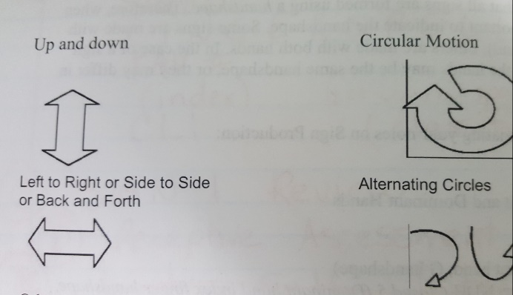
Concept 4: Defining Movement
Use words: tap, shake, quiver
Use pictures:
Indicate if the movement is produced more than 1 time:
  Two times (2x)
  Three times (+++)
GREEN = Repeated shaking motion
(2) SOMETIMES = DH repeated circular motion, NDH stationary (or still, or does not move)
(3) SCIENCE = Alternating circles

Slide 8
Concept 5: Defining Non-Manual Signal (NMS)
The English word is generally not indicated on the mouth. However, some ASL signs do incorporate unique mouth movements and/or head motions that are required for appropriate sign production
(1) GREEN = none used
(2) SOMETIMES = none used
(3) SCIENCE = none used

Slide 9
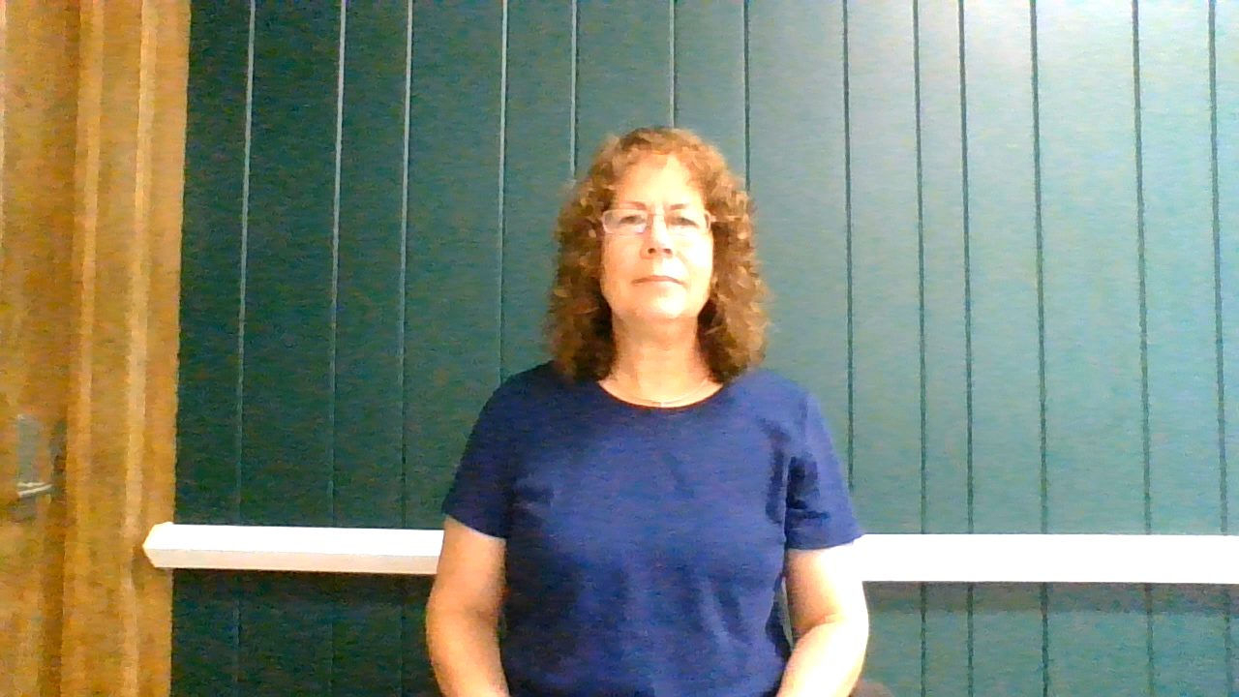
Putting the 5 Concepts Together
(1) GREEN = DH G, front, right side of body, palm left, repeated shaking motion

Slide 10

Putting the 5 Concepts Together
(2) SOMETIMES = DH index, palm inward, NDH closed 5, palm up, in center of body. DH index taps palm of NDH in repeated, circular motion

Slide 11

Putting the 5 Concepts Together
(3) SCIENCE = BOTH 10, palms out, in front of body, repeated alternating circles

Slide 12
Writing Sign Production
It is important to note that the abbreviations provided are instructor-generated examples; they are not a standardized method of indicating sign production.
The important thing is to understand the 5 Concepts. Each concept is an essential part of proper sign formation.

